Slide 1
Image Processing
Object Detection Using MATLAB
Made By:
Jigar Agrawal (011469796)
Vidhan Modi (011451362)

Slide 2
What is Object Detection
Object detection is the process of finding instances of real-world objects such as faces, buildings in images and as well as videos. [1]
There are several methods of detecting objects which includes:
Gradient Based Approach
Template matching Approach

Slide 3
Thresholding
Thresholding is used to create the binary image from multi-bit images.
Why binary image?
In non-adaptive thresholding the threshold value is not decided based on the image of interest. It is the same for all the images.
So, to make it more accurate we use Adaptive Thresholding.

Slide 4
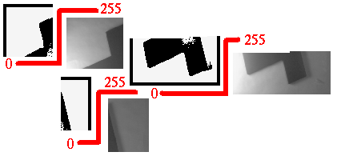
Global Adaptive Thresholding
Adaptive Thresholding is used to segment an image by setting all pixels whose intensity values are above a threshold to a foreground value and all the remaining pixels to a background value.[2]
Fig: Adaptive Thresholding[2]

Slide 5
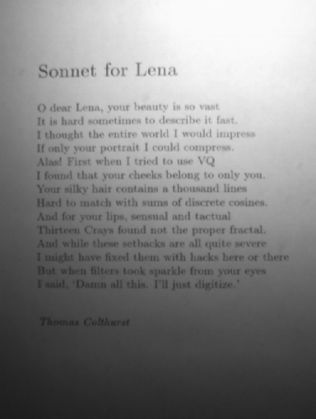
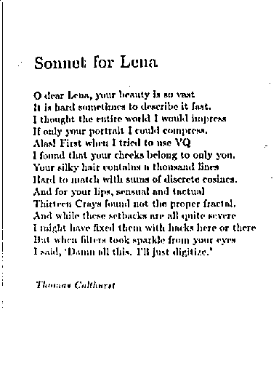
Local Adaptive Thresholding
In local thresholding the separate threshold is decided for individual pixels.
The threshold value depend on the neighborhood of the pixel.

Slide 6
Flowchart
Adaptive Thresholding
High Pass Filter, for edge detection
Filling the Object
Detecting the location of the object
Checking the neighborhood of filled connected objects

Slide 7
Future Expansion
Multiple object detection.
Hardware Acceleration using GPUs.

Slide 8
Applications
Face Detection
Automatic Target Detection in Guided Missiles
Security Systems

Slide 9
References
1. https://www.mathworks.com/discovery/object-detection.html
2. http://homepages.inf.ed.ac.uk/rbf/HIPR2/adpthrsh.htm

Slide 10
Any Questions ?

